Slide 1

Parsing ArcGIS Locator JSON using PHP

Slide 2
Three W's
Why are we using this online Geocoder to calculate sales taxes?
What is this technology?
Where do we get the elements to recreate this?

Slide 3
Why? Streamline Sales Tax
The Department of Finance and Administration needs to provide an address lookup for rates that are changed monthly depending on the laws passed by state and local legislatures.
This tool will use local data provided by the cities and counties across the state to give the most accurate data available.

Slide 4
What is the Streamlined Sales Tax Project (SSTP)?
The Streamlined Sales and Use Tax Project (SSTP) was initiated in March 2000 in order to develop a sales and use tax system that eases the burden of tax compliance for all retailers. Streamlined Sales Tax is a national effort by state and local governments and the private sector to simplify and modernize sales and use tax collection and administration. This national effort produced the “Streamlined Sales and Use Tax Agreement.”

Slide 5
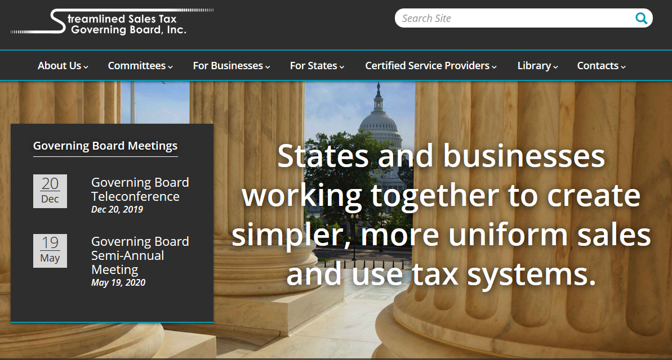
What is the Streamlined Sales Tax Project (SSTP)?
www.streamlinedsalestax.org

Slide 6
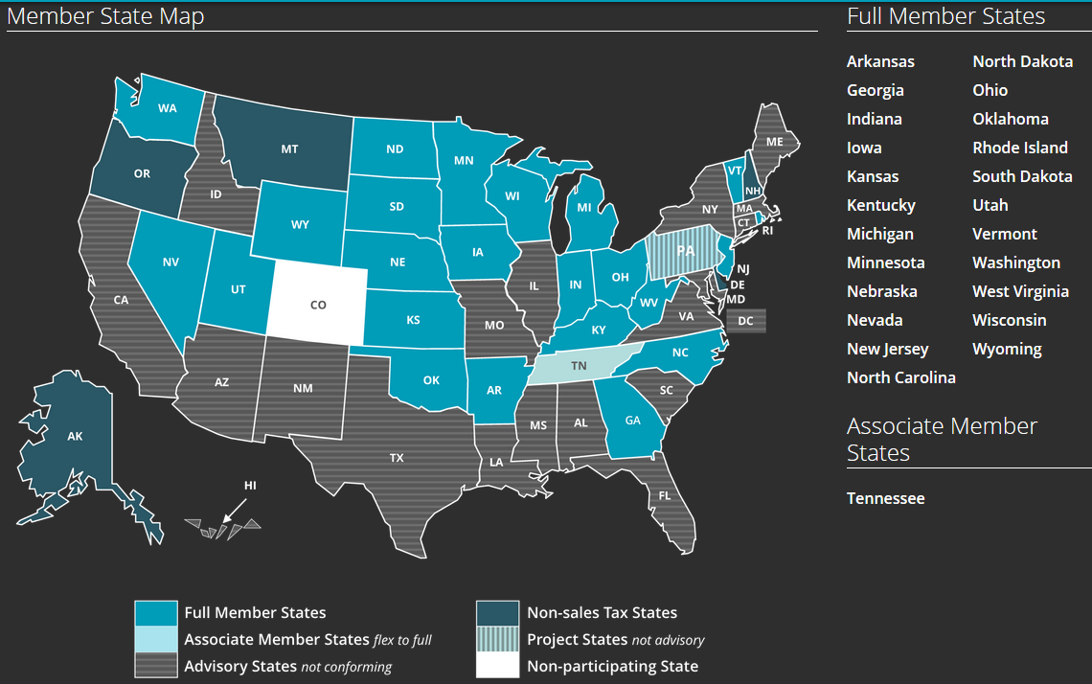
What states are implementing SSTP?
www.streamlinedsalestax.org

Slide 7
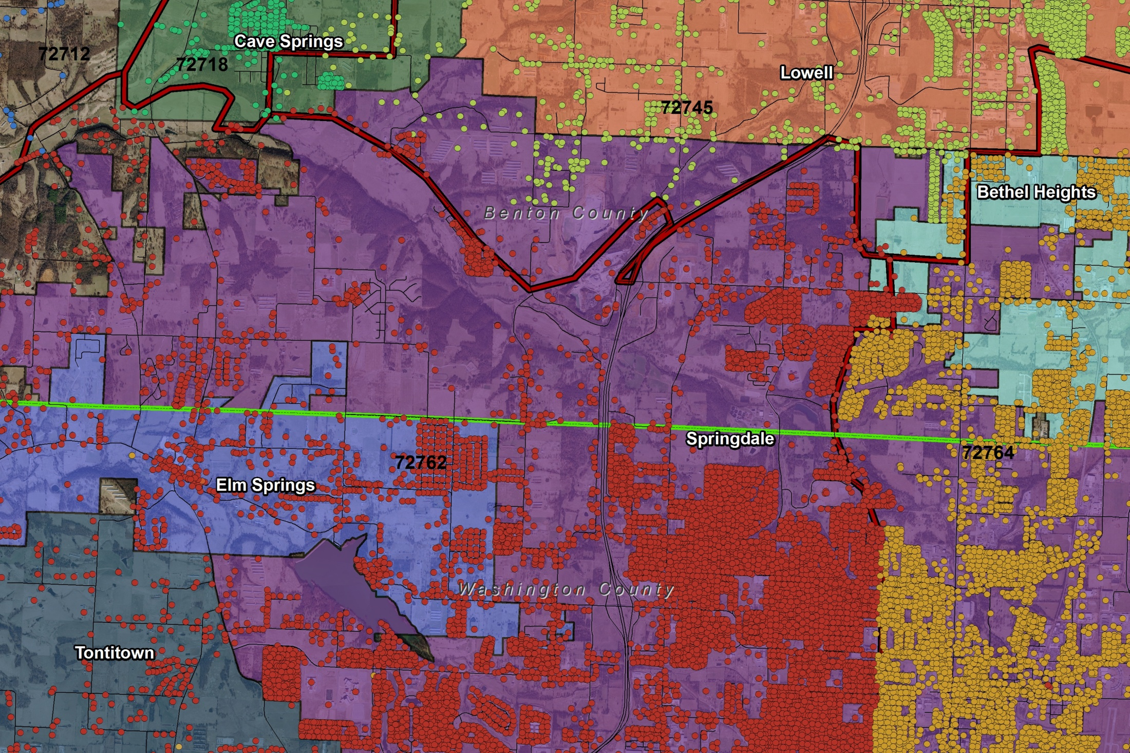
Why? SSTP Geocoding
Does this address reside within a municipal boundary? If it doesn’t, then no municipal sales tax is needed.

Slide 8
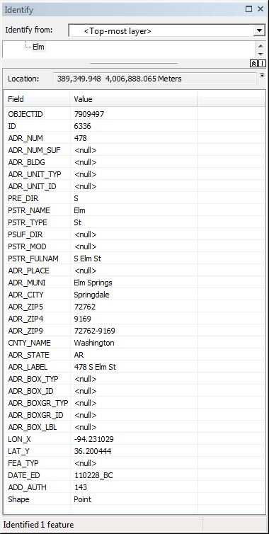
SSTP Geocoding
Address Points
Use the tax rates for this municipality.

Slide 9
SSTP Geocoding
Address Points
We need the state and county rates to calculate the final sales tax for this address lookup.

Slide 10



What? Here is our GIS Toolbox
ESRI REST Services
ArcGIS Composite Locator gis.arkansas.gov/arcgis/rest/services/Locator
Boundary MapServer Service
gis.arkansas.gov/../FEATURESERVICES/Boundaries/MapServer
Inputs: Zip code or Address data
Outputs: JSON candidates
PHP parses the output file_get_contents(url) json_decode(json)
Notes:
The acronym REST stands for Representational State Transfer, this basically means that each unique URL is a representation of some object.
REST technology is generally preferred to the more robust Simple Object Access Protocol (SOAP) technology because REST leverages less bandwidth, making it more suitable for internet usage.

Slide 11
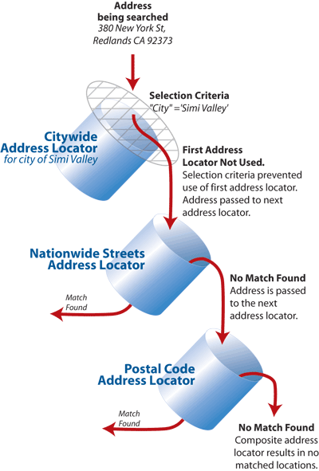
ESRI
The ESRI Composite Locator service is our core technology
By combining locators, we can rank them and insure that we can find the address
If we do not find the address, the locators will return possible matches

Slide 12
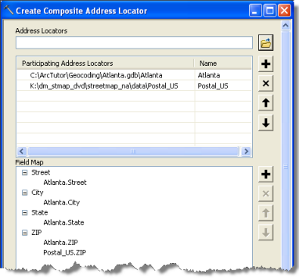
ESRI
When building a composite locator, each locator has specific address fields that it defines. Those names will be used in the PHP and JSON references.

Slide 13
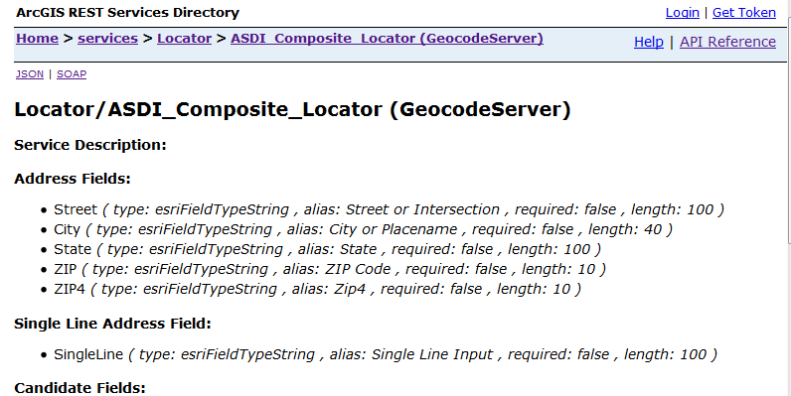
ESRI REST Service
Here is the home page of our core technology. Notice the Login, Help and API Reference links.
The JSON and SOAP links give the same information but in their applicable formats.

Slide 14
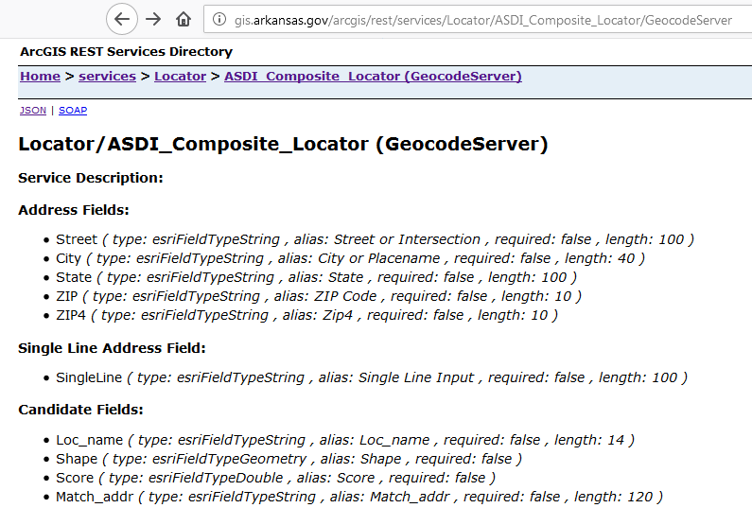
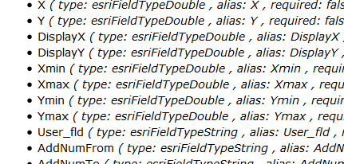
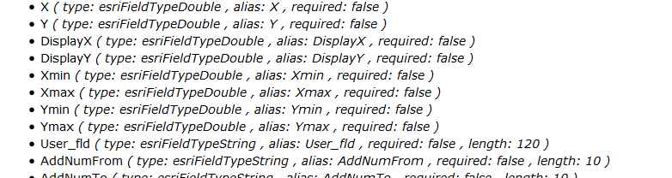
ESRI & JSON Fields
We will need the “User_fld” defined when the locator is created. Our locator returns FIPS or ZIP9 values in this field
This will be used later on in the PHP to acknowledge that we have Address results.

Slide 15
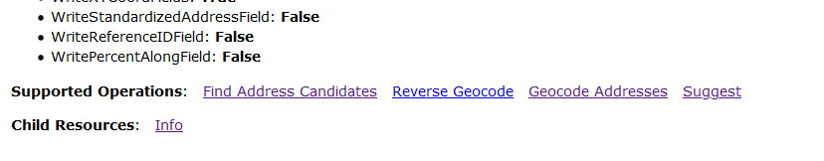
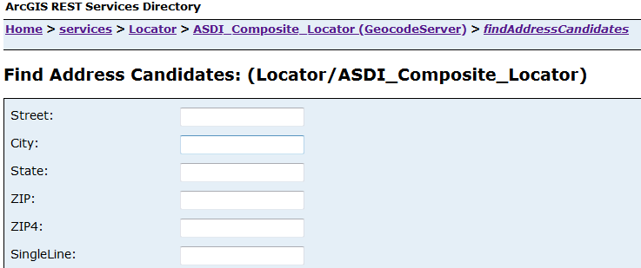
ESRI REST Service
We will use the Find Address Candidates in the call from PHP similar to this form page provided by this service.
You can use this from page to build your own query strings or test the results outside the PHP.

Slide 16
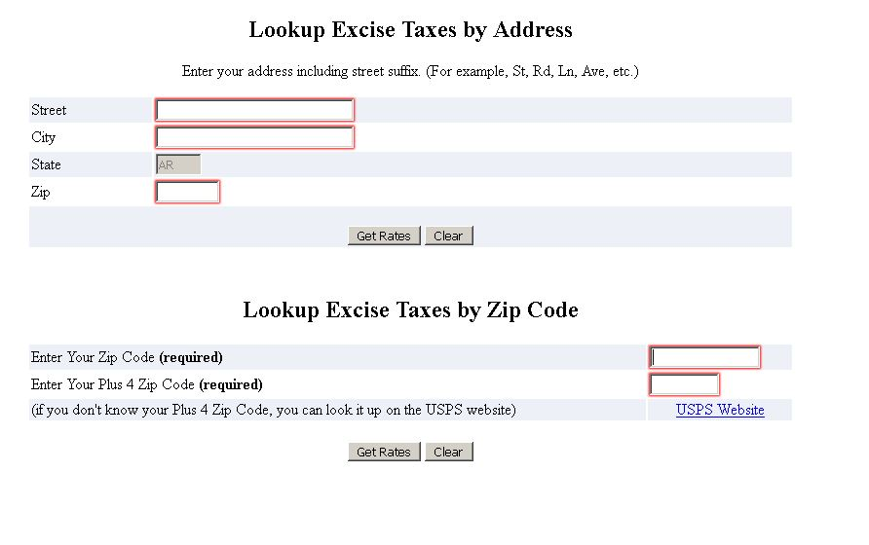
We can use Address or Zip Code input data to determine our tax rates.

Slide 17
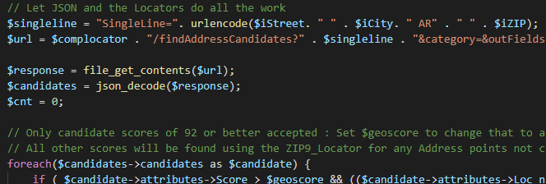
PHP
We build and encode the query string with the requested Address input.
We use file_get_contents to send the query string, get the response and json_decode to decode the response into an associative array.

Slide 18
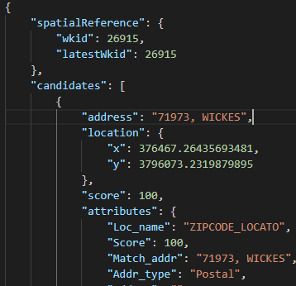
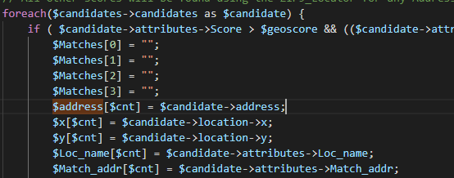
ESRI REST Service JSON & PHP
By using [GET] submit with the form manually in the REST service and select JSON output, we can see the candidates returned by the JSON. Here are the PHP references below.

Slide 19
ESRI REST Service JSON & PHP
By using [GET] submit with the form manually in the REST service and select JSON output, we can see the x and y location returned by the JSON. Here are the PHP references below.

Slide 20
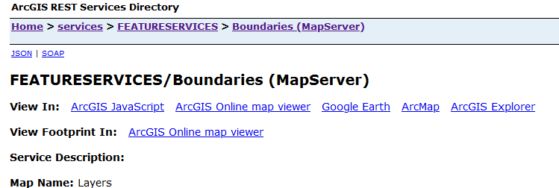

ESRI REST Service
The resulting json_decode PHP function will return and X and Y that we will then use in the Boundary REST service via the Identify.

Slide 21
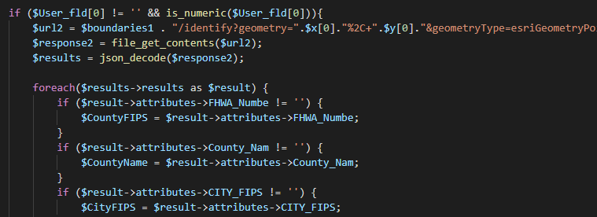
PHP
The Identify will use the X and Y to see which county boundary contains these values.
Not all X and Y will reside within a municipal boundary but if they do, we will get this value as well.

Slide 22
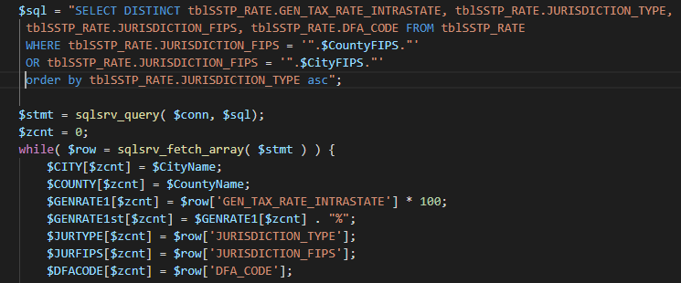
PHP & SQL
We will use the county and any applicable municipal values to pull those tax rates with SQL.

Slide 23
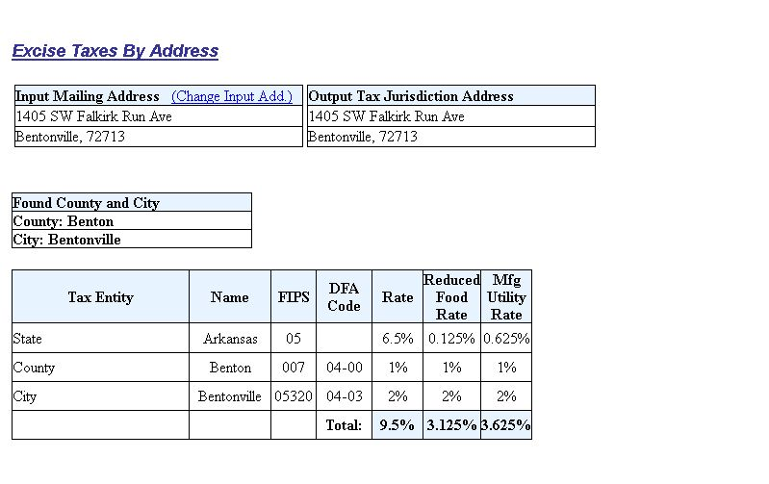
We output the resulting tax rates if the Address was found

Slide 24
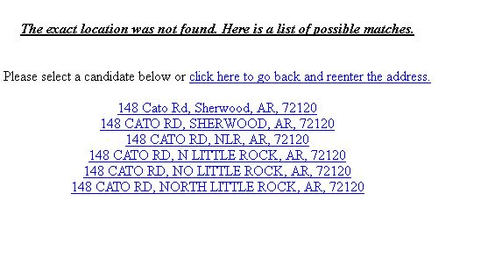
If a match of 93 percent or better is not found by the locators, we will return other possible matches. Here is where our locators help us once again.
Most matches under 93 are due to typos in the address inputs or that the address doesn’t exist. The above links gives the user the option to select the corrected address.

Slide 25

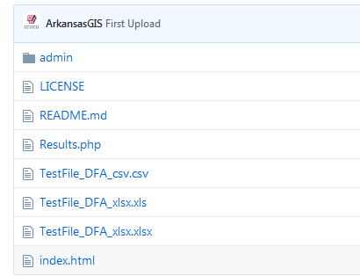
Where? GitHub and Your Host
https://github.com/ArkansasGIS/SSTLookup
Download and install to your IIS server

Slide 26
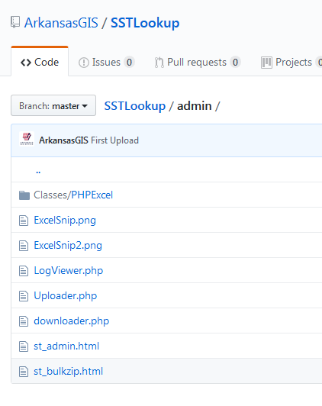
Where? Your Host
The admin folder has a log viewer and bulk geocoder for csv, xls and xlsx.
The bulk uploader requires read, write and delete privileges. I would suggest setting a password on the folder itself to limit abuse.

Slide 27


Where? Your Host
Are you using this code for Arkansas data?
https://gis.Arkansas.gov
All our ArcGIS REST services are open to the public
We maintain and update our data regularly from the county and municipal stewards.
Signup for updates that we send out monthly.
We can help get this installed on your system even if your not an Arkansan.
Contact mailto:wes.odonohue@Arkansas.gov

Slide 28
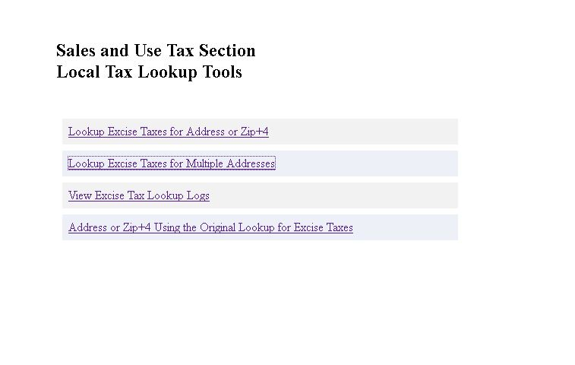
/admin

Slide 29
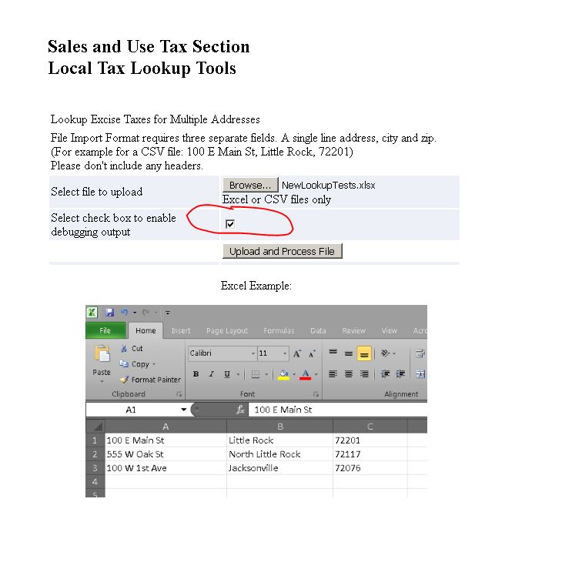
/admin/Uploader.php

Slide 30
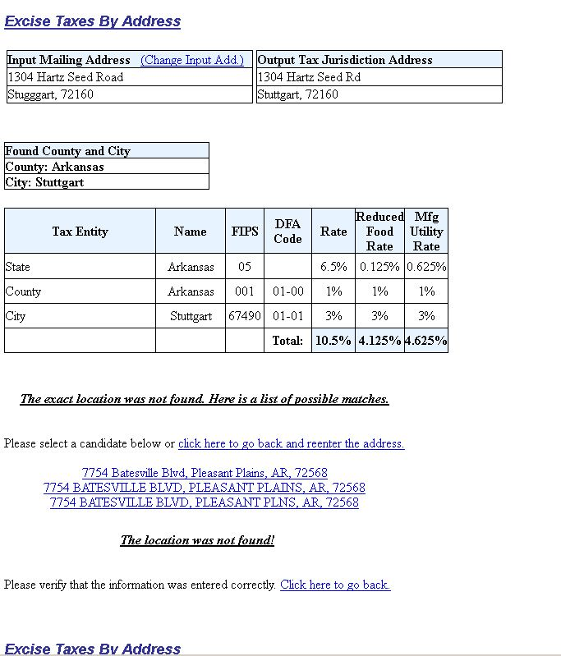
/admin/Uploader.php

Slide 31
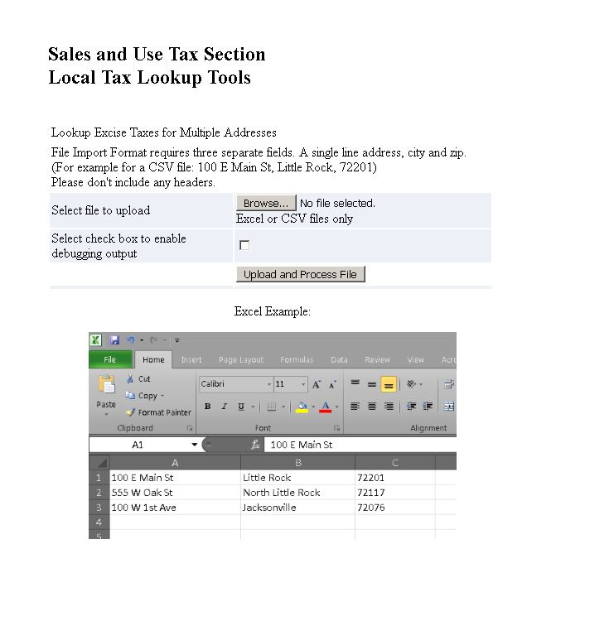
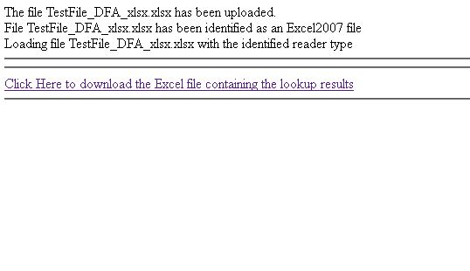
/admin/Uploader.php

Slide 32
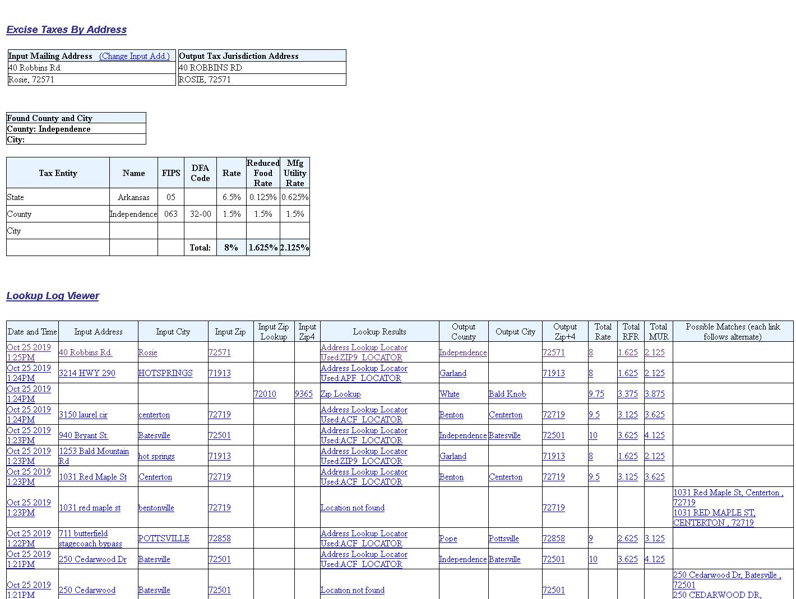
/admin/LogViewer.php

Slide 33
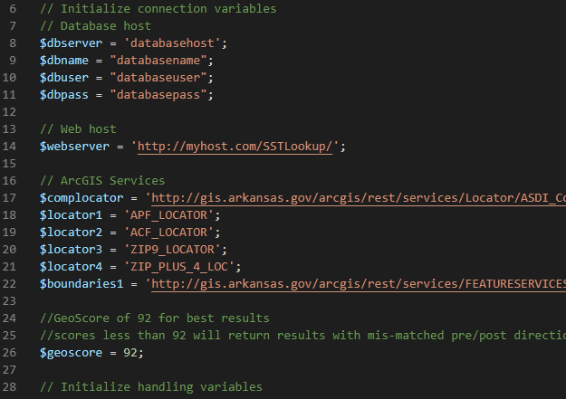
Short code walks through key elements
Results.php

